Slide 1


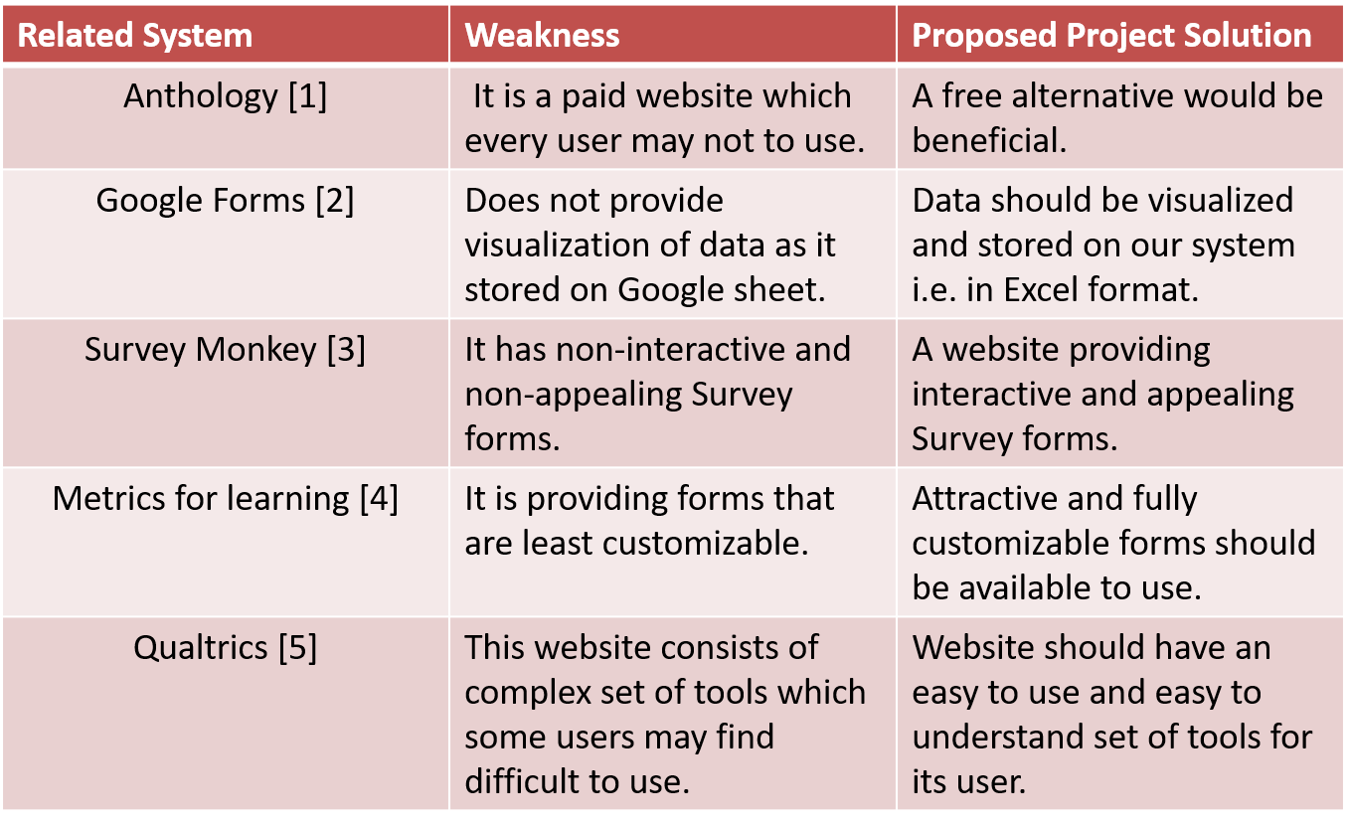
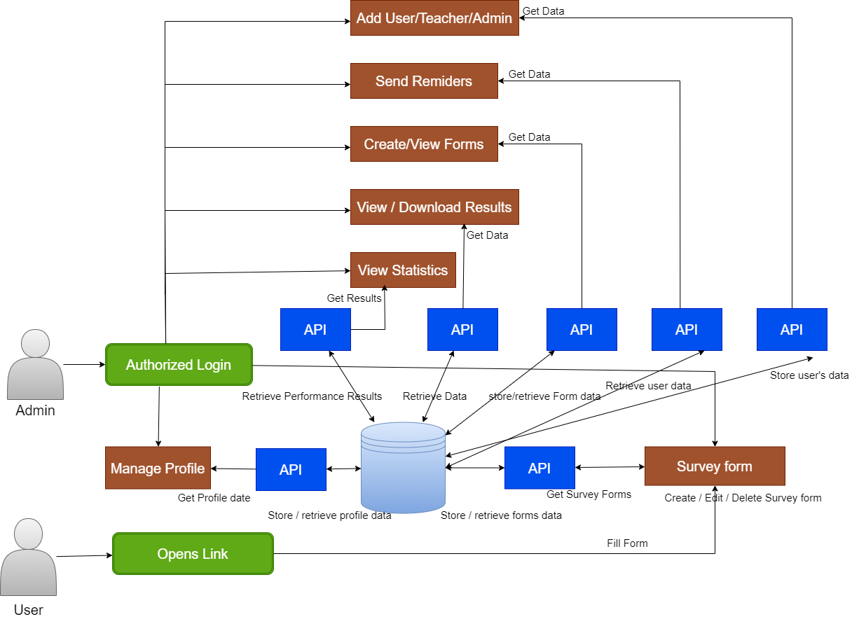
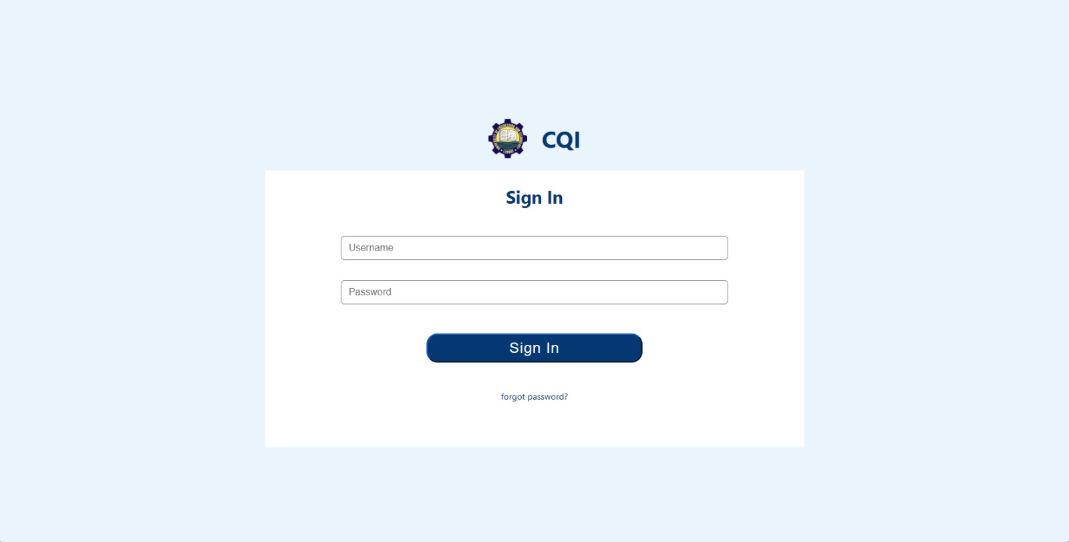
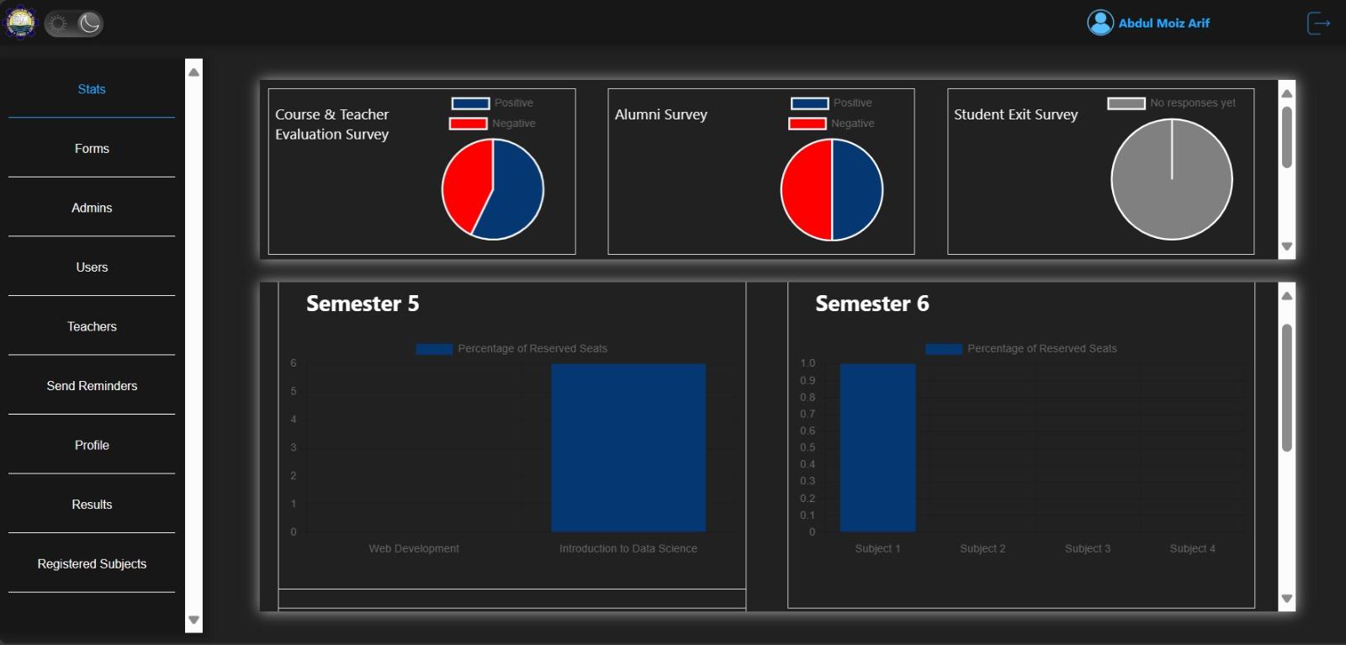
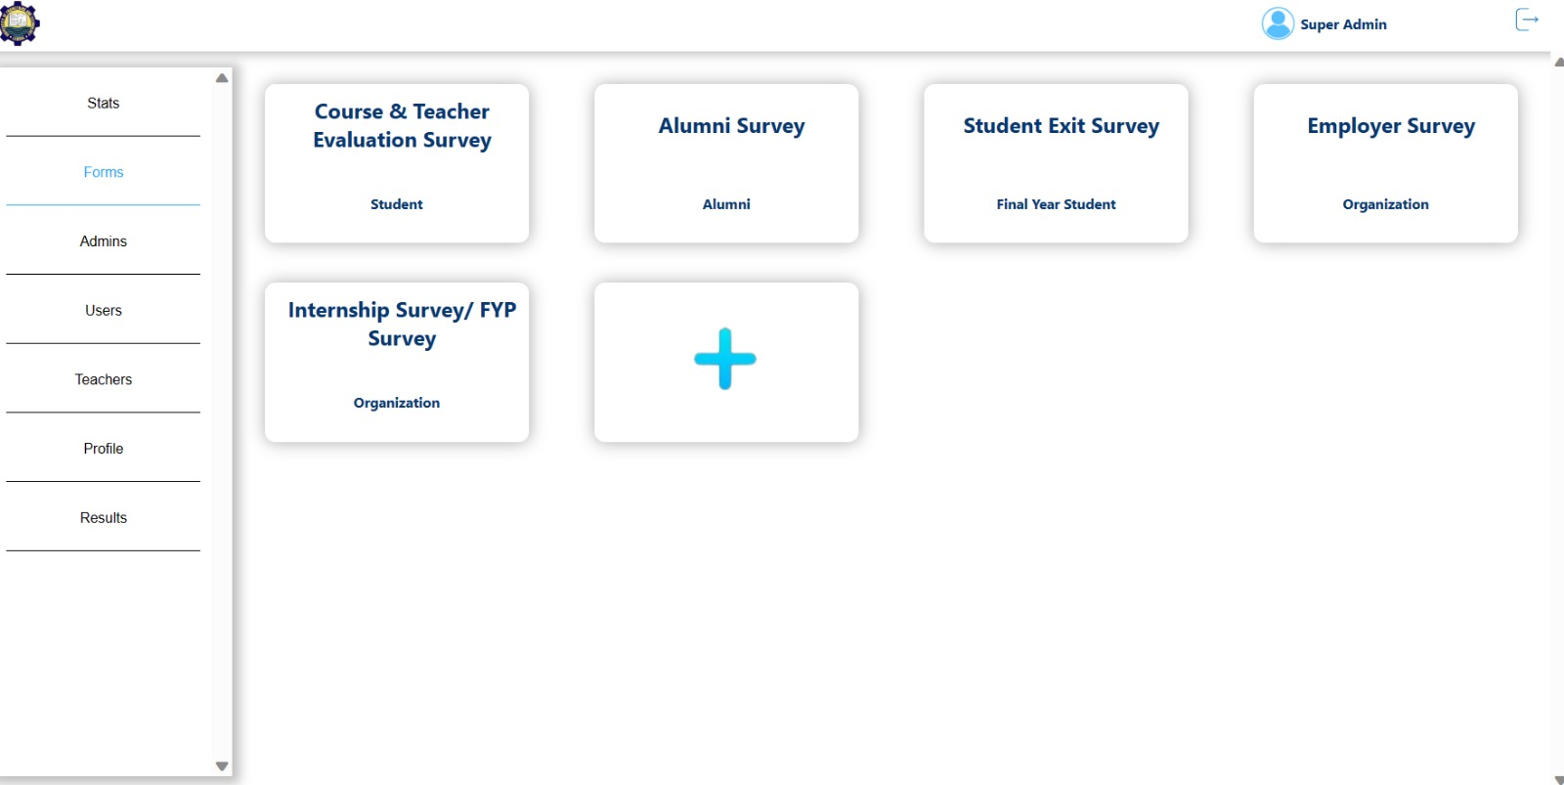
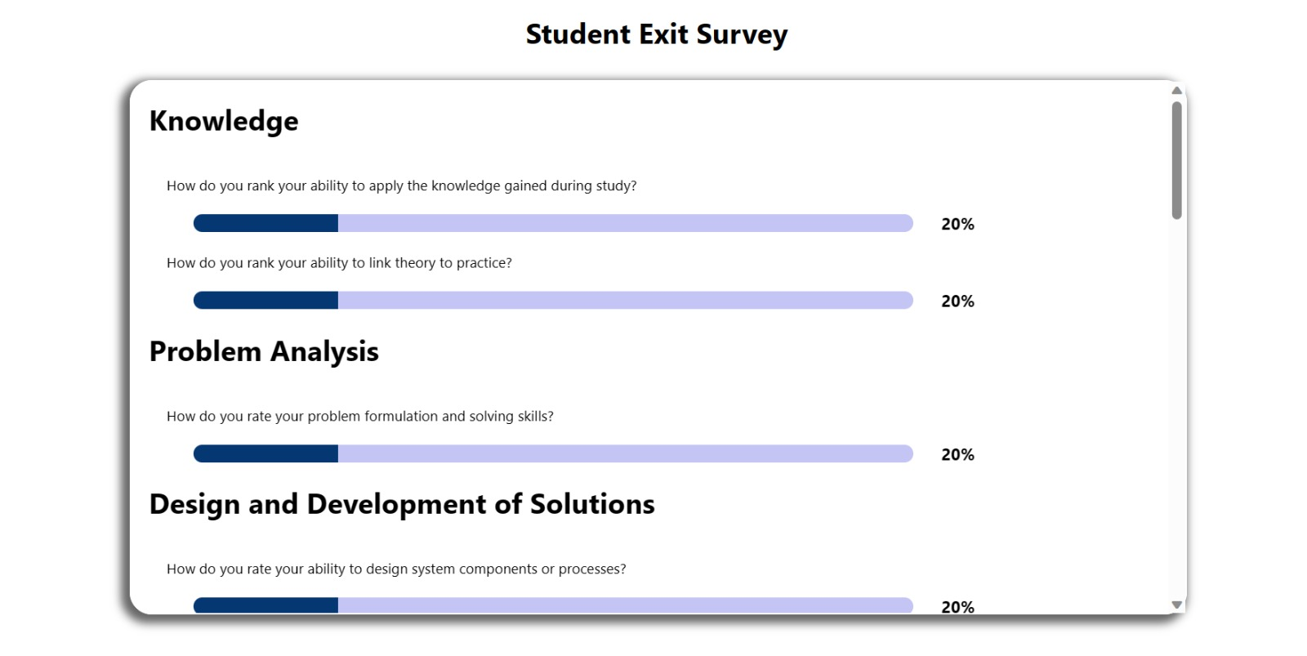
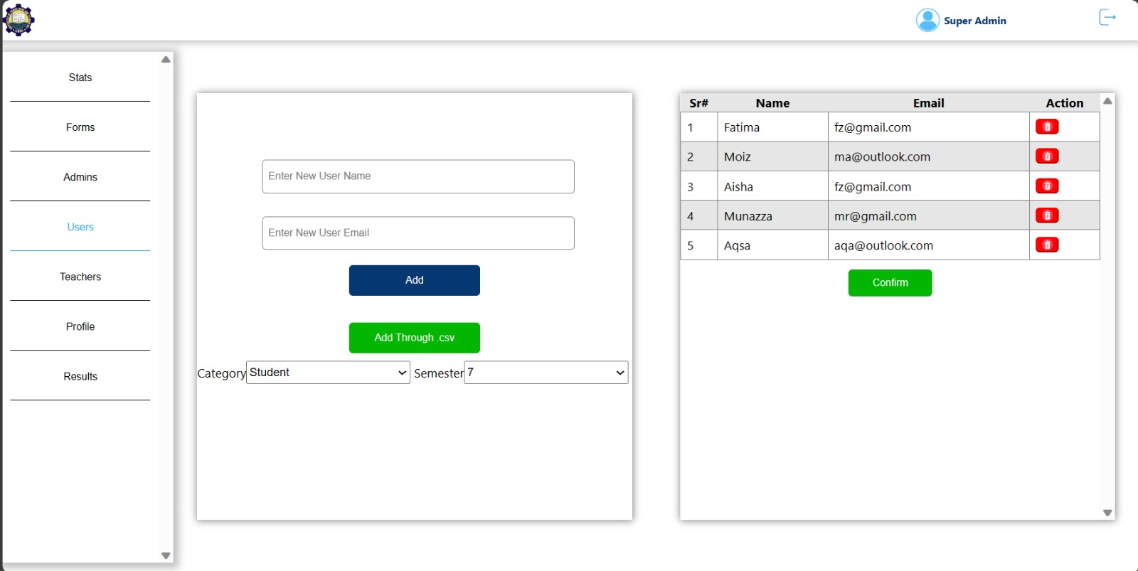
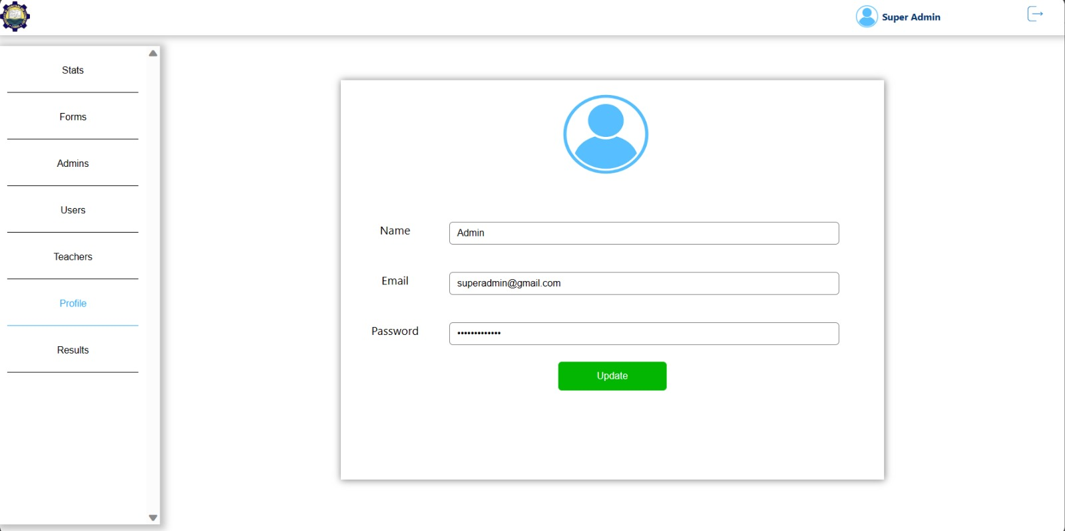
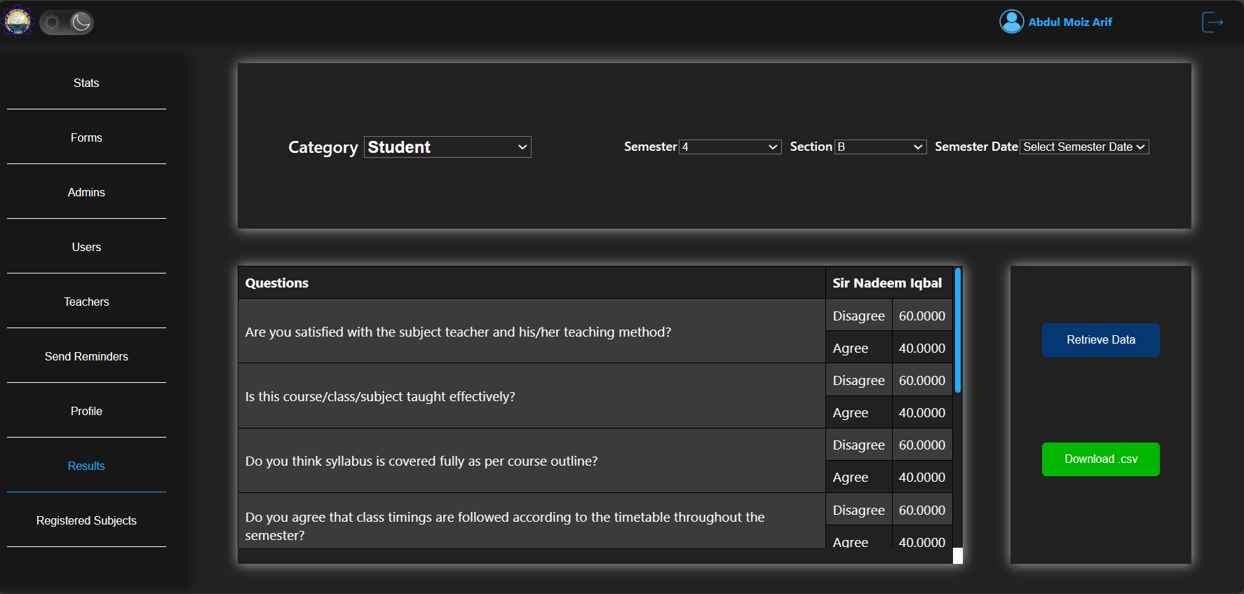
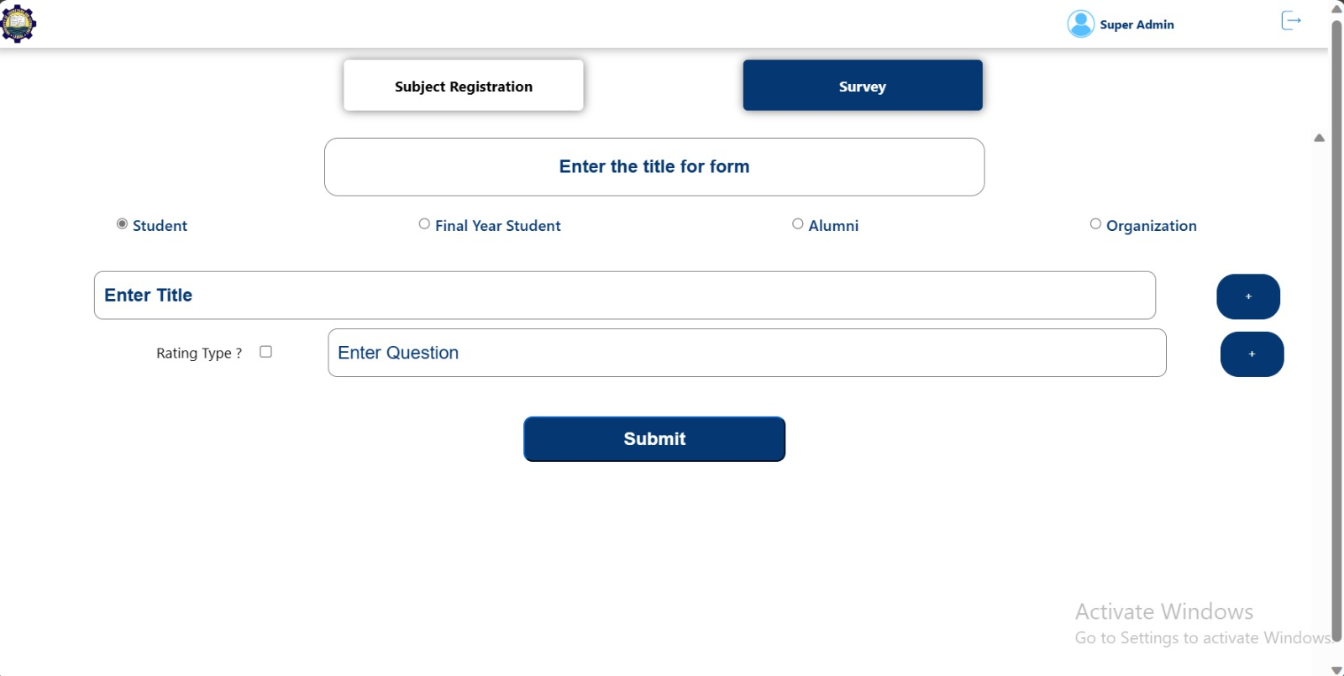
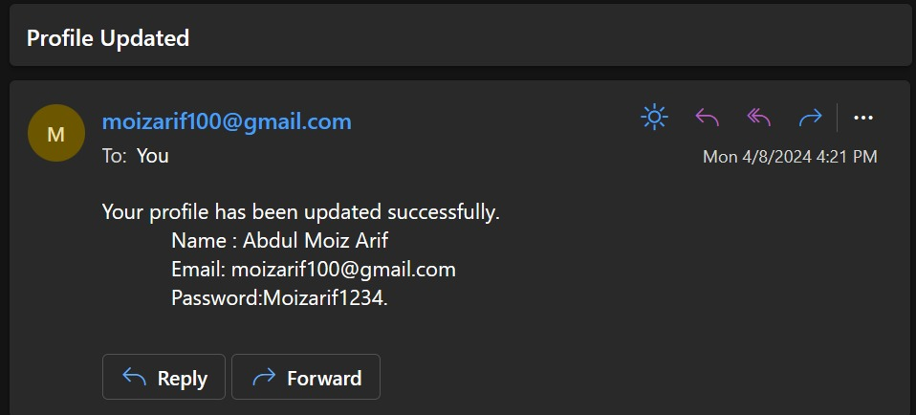
Automated CQI
Student Name : Abdul Moiz Arif – 2020cs674
Student Name : Fatima Zafar – 2020cs664
Student Name : Munazza Rafique – 2020cs687
Supervisor Name: Dr. Zeeshan Ramzan
Department of CS U.E.T, New Campus
U.E.T, Lahore, Pakistan
1
2
Introduction
Background:
Continuous Quality Improvement (CQI) systems are widely used in higher education institutions to assess and improve the quality of education. University of Engineering and Technology has incorporated a system of elective subject registration and outcomes i.e., CLO, PLO, PEO, that can help administration predict if the quality of education is up to the mark or not.
Motivation:
The motivation for this project stems from the need to improve the quality of education by providing a user-friendly and convenient platform for data collection and analysis.
Problem Statement:
Inefficient, time-consuming and difficult to use traditional methods of collecting and analyzing student feedback data pose a challenge in higher education institutions, leading to delayed insights and decision-making.
Also reliance on Google forms for seat reservation in elective subjects pose issue of bogus seat reservations, causing problems to Admin staff, and students who couldn’t reserve seats due to unavailability.
Related Work
3
Objectives
• To provide an efficient system for registration of elective subjects.
• To provide an efficient, user friendly and quick system for conducting student surveys
• To provide insights obtained from the surveys in a usable and convenient format for further analysis
• To visualize the data in such manner that it is easy to comprehend and examine the change over time
• To enhance the overall quality of education by providing a platform for continuous quality improvement that maintains a record of Quality Enhancement over time
4
5
Features
Super Admin Capabilities
User Management: Ability to add or remove Admins, Students, and Teachers.
Data Entry: Options to upload data via .csv file or manual entry.
Survey Management: Creation, editing, and deletion of surveys.
Admin Functions
User Management: Admins have the ability to add or remove Students and Teachers.
Profile Management: Admins can update their own profile information and recover passwords.
Survey Operations
Form Creation: Super Admins and Admins can create subject registration forms.
Report Handling: Ability to view, download survey reports in Microsoft Excel format, and access survey analytics.
User Engagement
Survey Participation: Students, Teachers, Alumni, and Organizations can fill out surveys designed for them.
Notifications: Automated email notifications for new forms and surveys.
System Architecture
6
Working Demo
7
Conclusion
By harnessing the capabilities of this system, institutions can embark on a journey of continuous improvement, where data-driven strategies are employed to tailor educational offerings to the evolving needs of the student body. The system's robust analytics tools enable educators to identify trends, pinpoint areas for enhancement, and implement targeted interventions that can lead to a more enriching educational environment.
Moreover, the integration of personal profile-based seat reservations is a testament to the system's commitment to authenticity and reliability. This feature ensures that the data collected is a true reflection of student engagement, free from the influence of spurious entries. It not only streamlines the administrative process but also reinforces the credibility of the data, which is crucial for making informed decisions that can shape the future of education.
In essence, the deployment of this system signifies a step forward in the pursuit of academic excellence. It aligns with the overarching goal of higher education institutions to provide a quality education that is both accessible and adaptable to the needs of today's learners. As such, it stands as a beacon of innovation, poised to redefine the educational landscape and foster an environment where students and educators alike can thrive
References
[1] Anthology. https://www.campuslabs.com/campus-labs-platform/ improvement-and-accountability/studies-and-instruments/ last accessed October 10, 2023
[2] Google forms. https://www.google.com/forms/about/ last accessed October 10, 2023
[3] Survey monkey. https://www.surveymonkey.com/ last accessed October 10, 2023
[4] Metrics for learning. https://www.metricsforlearning.com/ last accessed October 10, 2023
[5] Qualtrics. https://www.qualtrics.com/ last accessed October 10, 2023
[6] Json to csv. https://www.npmjs.com/package/react-json-to-csv last accessed November 10, 2023
[7] React hooks. https://legacy.reactjs.org/docs/hooks-overview.html last accessed November 12, 2023

